Slide 1
[Interview] Artificial Intelligence (AI) Computer Vision (CV)
Kim Wonjin
Date: 17 / 08 / 2019
Version: 2.1

Slide 2
Version History
Version 1.0 (10/08/2019)
First created
Version 2.0 (11/08/2019)
Add the contents of Computer Vision
Version 2.1 (17/08/2019)
Fix Korean font issue

Slide 3
Q. Different between AI, ML, and DL.
AI
Originated 1950s
Represents simulated intelligence in machines
A subset of Data science
To build machines which are capable of thinking like human
ML
Originated 1960s
Is the practice of getting machines to make decisions w/o being programmed
A subset of AI
To make machines learn through data so that they can solve problems
DL
Originated 1960s
Is the process of using ANN to solve complex problems
A subset of ML
To build neural networks that automatically discover patterns for feature detection

Slide 4
Q. What is AI?
Artificial Intelligence(AI) is an area of computer science that emphasizes the creation of intelligent machines that work and react like humans
인공지능은 컴퓨터 과학의 분야로 인간처럼 행동하고 생각하는 지능형 컴퓨터 시스템을 의미
The capability of a machine to imitate the intelligent human behavior
학습을 통해 인간의 행동을 모방하는 능력 탑재
[Additional Info.]
AI is a field of CS wherein the cognitive functions of the human brain are studied and tried to be replicated on a machine/system. AI is today widely used for various applications like computer vision, speech recognition, decision-making, perception, reasoning, cognitive capabilities, and so on

Slide 5
Q. What are different types of AI [1]
Reactive Machines AI
Based on present actions, it cannot use previous experiences to from current decisions and simultaneously update their memory
미래를 예측해서 판단을 내리는 유형
Limited Memory AI
Used in self-driving cars. They detect the movement of vehicles around them constantly and add it to their memory
과거의 경험을 잠깐 저장해서 판단을 내리는 유형
Theory of Mind AI
Advanced AI that has the ability to understand emotions, people and other things in the real world
타인의 마음의 상태를 알아내서 상호작용할 수 있는 유형
Self Aware AI
AIs that posses human-like consciousness and reactions. Such machines have the ability to form self-driven actions
자신이 무엇을 하는지 아는 “자기인식＂ 유형
[1] 오요한, and 홍성욱. "인공지능 알고리즘은 사람을 차별하는가?." 과학기술학연구 18.3 (2018): 153-215.

Slide 6
Q. Different domains of AI
Machine Learning (ML)
It’s the science of getting computers to act by feeding them data so that they can learn a few tricks on their own, without being explicitly programmed to do so
Neural Networks (NN)
They are a set of algorithms and techniques, modeled in accordance with the human brain. NN are designed to solve complex and advanced machine learning problems
Robotics (Author: similar as Reinforcement Learning)
These Robots are artificial agents acting in a real-world environment. An AI Robot works by manipulating the objects in it’s surrounding, by perceiving, moving and taking relevant actions
Expert Systems
An expert system is a computer system that mimics the decision-making ability of a human.
Fuzzy Logic Systems
Fuzzy logic is an approach to computing based on “degrees of truth” rather than the usual “true or false” (1 or 0) Boolean logic on which the modern computer is based

Slide 7
Q. Different types of ML
Supervised Learning
Using labeled data
Problem: Regression & Classification
Approach: Map labeled input to known output
Ex. Linear regression, Logistic regression, Support Vector Machine, KNN
Unsupervised Learning
Using unlabeled data
Problem: Association & Clustering
Approach: Understand patterns and discover output
Ex. K-means, DBSCAN
Reinforcement Learning
The action data by environment of current state
Problem: Reward based
Approach: Follow trail and error method
Ex. Q-Learning

Slide 8
Q. What is Q-Learning?
Q-learning
Q-learning is a Reinforcement Learning algorithm in which an agent tries to learn the optimal policy from its past experiences with the environment. The past experiences of an agent are a sequence of state-action-rewards
Q-learning은 강화학습의 한 종류로, agent가 과거 환경에 대한 경험을 통해 최적의 행동(Acting)을 배우려고 하는 학습 방법이다. 여기서 과거 경험은 상태-행동-보상의 시퀀스이다.

Slide 9
Q. What is DL?
Deep Learning (DL)
DL imitates the way our brain works (it learns from experiences). It uses the concepts of neural networks to solve complex problems
인간의 생각 방법을 모방하여 학습하는 방법이며, 복잡한 문제를 해결하기에 용이하다. 우리가 쉽게 풀 수 없는 문제, 즉 수식을 세우기 어려운 문제에 적합하다.
It consists of three types of layers:
Input Layer: This layer receives all the inputs and forwards them to the hidden layer for analysis
Hidden Layer: In this layer, various computations are carried out and the result is transferred to the output layer. There can be N number of hidden layers, depending on the problem you’re trying to solve
Output Layer: This layer is responsible for transferring information from the neural network to the outside world
It has self-learning capabilities based on previous instance, and it provides high accuracy

Slide 10
Q. What is commonly used ANN?
Feedforward Neural Network (FNN)
Simplest form of ANN. The input data travels in one direction
May or may not have hidden layers
Convolutional Neural Network (CNN)
Input features are taken in batch wise like a filter
Mainly used for signal and image processing
Recurrent Neural Network (RNN) – Long Short Term Memory (LSTM)
Works on the principle of saving the output of a layer and feeding this back to the input to help in predicting the outcome of the layer
This way each neuron will remember some information It had in the previous step
AutoEncoders (AE)
These are unsupervised learning models with an input layer, an output layer and one or more hidden layers connecting them
The output layer has the same number of units as the input layer. Its purpose is to reconstruct its own inputs

Slide 11
Q. What are Bayesian Network?
Bayesian Network
A Bayesian network is a statistical model that represents a set of variables and their conditional dependencies in the form of a directed acyclic graph
베이즈 네트워크는 변수와 조건들을 방향성 비순환 그래프로 나타낼 수 있는 통계학적 모델이다.

Slide 12
Q. To test the intelligence of a machine
Turing Test
In AI, a Turing test is a method of inquiry for determining whether or not a computer is capable of thinking like a human being
The turing test is a method to test a machine’s ability to match the human-level intelligence
A machine is used to challenge human intelligence, and when it passes the test it is considered intelligent
Yet a machine could be viewed as intelligent without sufficiently knowing how to mimic a human

Slide 13
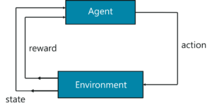
Q. Reinforcement work?
Two main components:
An agent
An environment
State -> Action -> Reward -> Next State (Repeat)
[Not essential]
The environment is the setting that the agent is acting on and the agent represents the RL algorithm
The RL process starts when the environment sends a state to the agent, which then based on its observations, takes an action in response to that state
In turn, the environment sends the next state and the respective reward back to the agent. The agent will update its knowledge with the reward returned by the environment to evaluate its last action
The loop continues until the environment sends a terminal state, which means the agent has accomplished all his tasks

Slide 14
Q. What is Markov’s decision process?
The mathematical approach for mapping a solution in RL is called Markov’s Decision Process (MDP)
RL에서 솔루션을 매핑하는 수학적 접근 방식
Set of actions, A
Set of states, S
Reward, R
Policy, Pi
Value, V

Slide 15
Q. Difference between parametric & non- models
Parametric Model
Uses a fixed number of parameters to build the model
Considers strong assumptions about the data
Computationally faster
Require lesser data
Ex. Logistic Regression, Naïve Bayes models
Non-parametric Model
Uses flexible number of parameters to build the model
Considers fewer assumptions about the data
Computationally slower
Require more data
KNN, Decision Tree

Slide 16
Q. Difference between Hyper params and model params
Model parameters
The features of training data that will learn on its own during training
Ex. Weights and Biases / Split points in Decision Tree
Internal to the model and their value can be estimated from data
Hyperparameters
The parameters that determine the entire training process
Ex. Learning rate / Hidden layers / Hidden units
External to the model and their value cannot be estimated from data

Slide 17
Q. Hyperparameters in DNN
Hyperparameters are variables that define the structure of the network. (Ex. Variables such as learning rate, hidden units)
They are used to define the number of hidden layers that must be present in a network.
More hidden units can increases the accuracy of the network, whereas a lesser number of units may cause underfitting.

Slide 18
Q. Hyperparameter optimization algorithm
Grid Search
Trains the network for every combination
주어진 공간 내에서 모든 조합을 학습시켜 가장 좋은 결과일 때의 매개변수를 취하는 방법
시간이 오래 걸리며, 최적 해를 못 찾을 수도 있음
Random Search
Randomly samples the search space and evaluates sets from a particular probability distribution
무작위로 매개변수를 설정하여 모델을 학습시키는 방법
매개변수의 범위나 간격 등을 설정해야 함
Bayesian Optimization
Includes fine-tuning the hyperparameters by enabling automated model tuning

Slide 19
Q. Overfitting occurrence & How to fix?
Overfitting
Occurs when a statistical model or machine learning algorithm captures the noise of the data. This causes an algorithm to show low bias but high variance in the outcome
[Cross-validation]
To split the training data in order to generate multiple mini train-test splits
[More training data]
Feeding more data to the machine learning model can help in better analysis and classification, But this does not always work
[Remove features]
Many times, the data set contains irrelevant features of predictor variables that are not needed for analysis
[Early stopping]
[Regularization]
Can be done in N number of ways, the method will depend on the type of learner you’re implementing. Ex. Dropout

Slide 20
Q. Deep learning framework
Keras
Is an open source neural network library written in Python. It is designed to enable fast experimentation with deep neural networks
Tensorflow
Is an open-source software library for dataflow programming. It is used for machine learning applications like neural networks
PyTorch
Is an open source machine learning library for Python, based on Torch. It is used for applications such as natural language processing

Slide 21
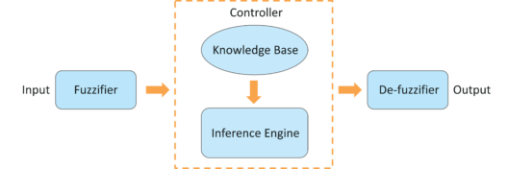
Q. Fuzzy logic architecture
Four components:
Fuzzification Module
The system inputs are fed into the Fuzzifier, which transforms the inputs into fuzzy sets
Knowledge Base
It stores analytic measures such as IF-THEN rules provided by experts
Inference Engine
It simulates the human reasoning process by making fuzzy inference on the inputs and IF-THEN rules
Defuzzification Module
It transforms the fuzzy set obtained by the inference engine into a crisp value

Slide 22
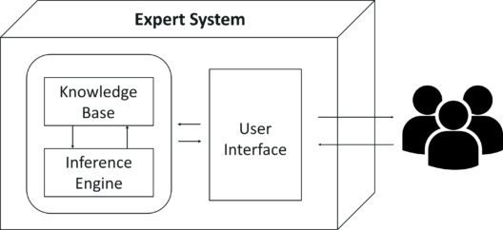
Q. Expert Systems
Three Components:
Knowledge Base
It contains domain-specific and high-quality knowledge
Inference Engine
It acquires and manipulates the knowledge from the knowledge base to arrive at a particular solution
User Interface
The user interface provides interaction between the user and the Expert System itself

Slide 23
Q. Computer vision and AI related
Computer Vision is a field of AI that is used to obtain information from images or multi-dimensional data
Machine Learning algorithms such as K-means is used for Image Segmentation, Support Vector machine is used for Image Classification and so on
Therefore Computer Vision makes use of AI technologies to solve complex problems such as Object Detection, Image Processing, etc

Slide 24
Q. Which is better for image classification?
Supervision
The images are manually fed and interpreted by the Machine Learning expert to create feature classes
Unsupervision
The Machine Learning software creates feature classes based on image pixel values
Therefore, it is better to choose supervised classification for image classification in terms of accuracy

Slide 25
Q. Facebook’s Face verification
Facebook uses DeepFace for face verification.
Input
환경적 요소가 가미된 다양한 얼굴 이미지 획득 (wild format)
Process
Detect facial features (얼굴 특징 추출)
Align and compare the features (얼굴 특징을 비교하기 위해 정렬)
Represents the key patterns by using 3D graphs (3D 그래프를 활용하여 키 패턴 표현)
Classify the images based on similarity (학습된 데이터와 유사도를 비교하여 얼굴 비교)

Slide 26
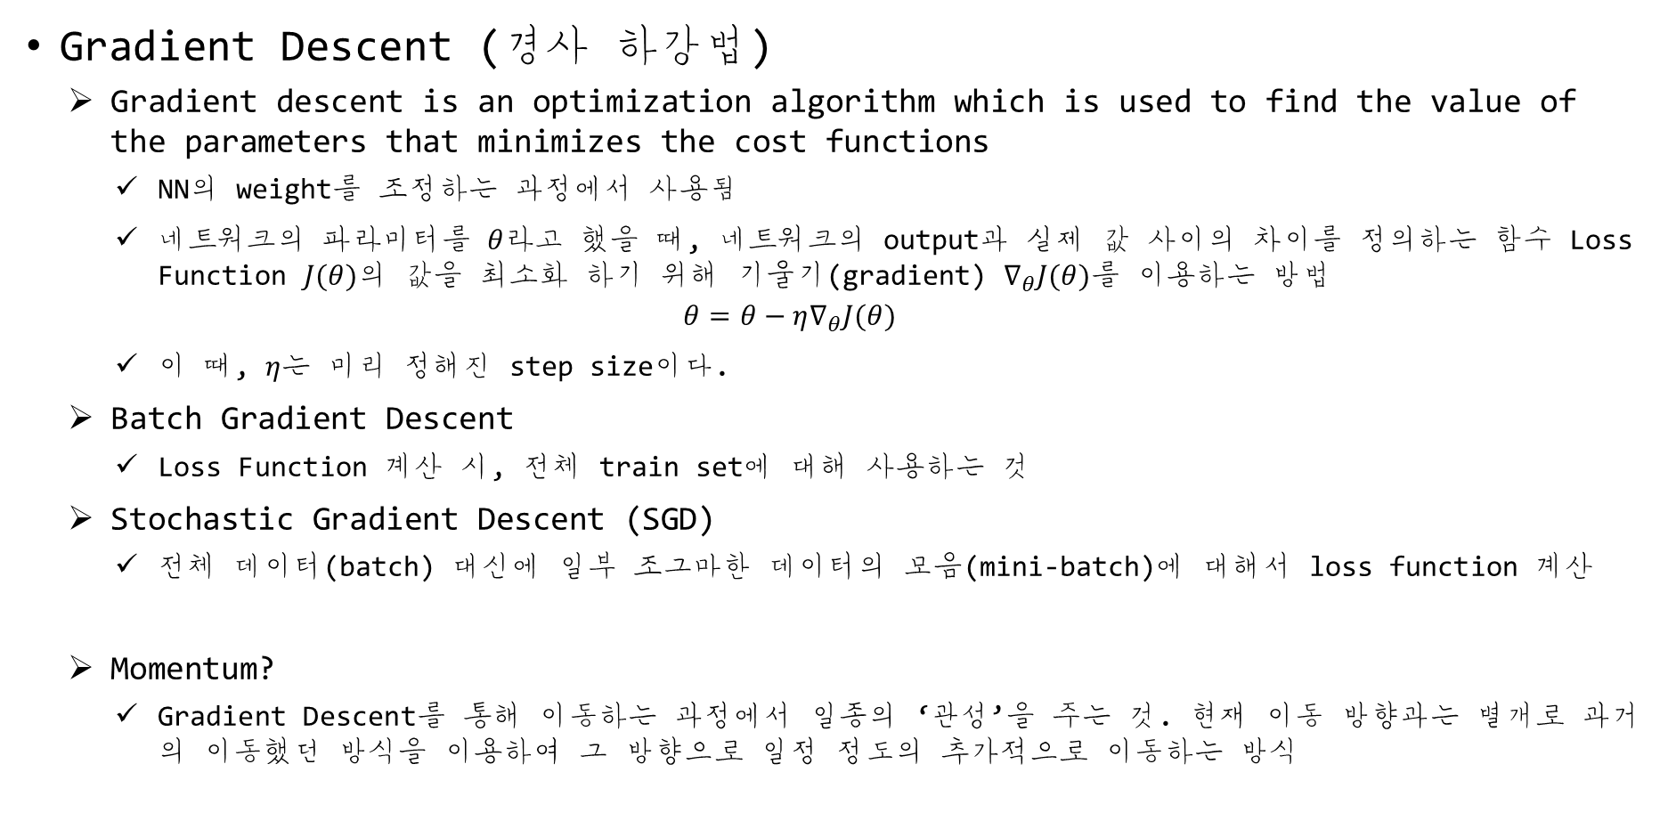
Q. What is gradient descent?
Gradient Descent (경사 하강법)
Gradient descent is an optimization algorithm which is used to find the value of the parameters that minimizes the cost functions
NN의 weight를 조정하는 과정에서 사용됨
네트워크의 파라미터를 $θ$라고 했을 때, 네트워크의 output과 실제 값 사이의 차이를 정의하는 함수 Loss Function $J(θ)$의 값을 최소화 하기 위해 기울기(gradient) $∇_{θ}J(θ)$를 이용하는 방법
$$θ=θ−η∇_{θ}J(θ)$$
이 때, $η$는 미리 정해진 step size이다.
Batch Gradient Descent
Loss Function 계산 시, 전체 train set에 대해 사용하는 것
Stochastic Gradient Descent (SGD)
전체 데이터(batch) 대신에 일부 조그마한 데이터의 모음(mini-batch)에 대해서 loss function 계산
Momentum?
Gradient Descent를 통해 이동하는 과정에서 일종의 ‘관성’을 주는 것. 현재 이동 방향과는 별개로 과거의 이동했던 방식을 이용하여 그 방향으로 일정 정도의 추가적으로 이동하는 방식

Slide 27
[Additional] Gradient Descent algorithm
Step 1
Allocate weights (x, y) with random values and calculate the error (SSE)
Step 2
Calculate the gradient, i.e., the variation in SSE when the weights (x, y) are changed by a very small value. This helps us move the values of x and y in the direction in which SSE is minimized
Step 3
Adjust the weights with the gradients to move toward the optimal values where SSE is minimized
Step 4
Use new weights for prediction and calculating the new SSE
Step 5
Repeat Step 2 and 3 until further adjustments to the weights do not significantly reduce the error

Slide 28
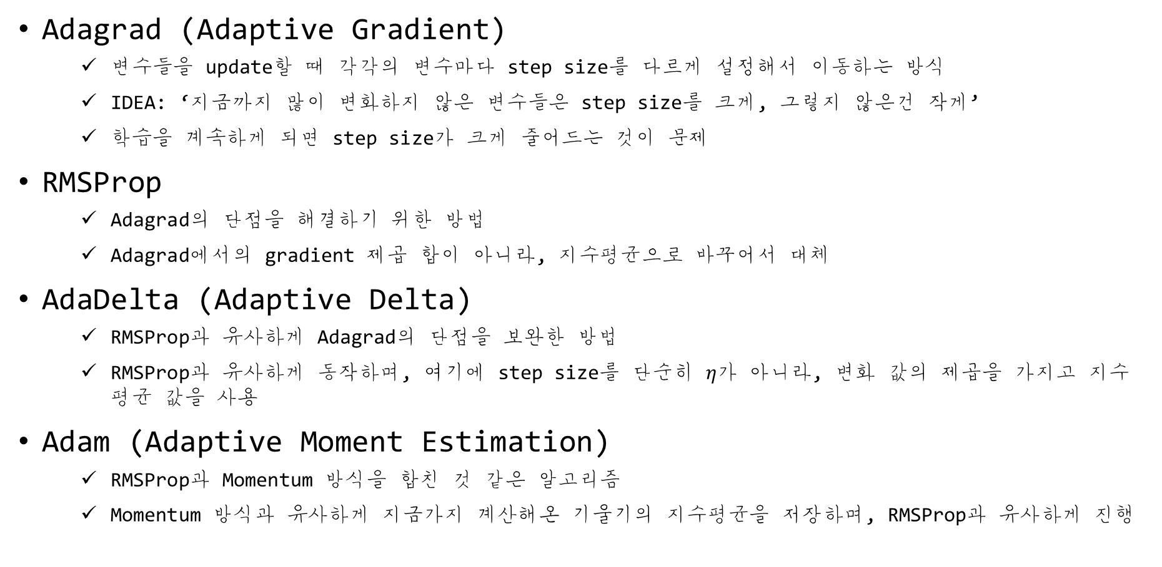
Q. Optimization Function?
Adagrad (Adaptive Gradient)
변수들을 update할 때 각각의 변수마다 step size를 다르게 설정해서 이동하는 방식
IDEA: ‘지금까지 많이 변화하지 않은 변수들은 step size를 크게, 그렇지 않은건 작게’
학습을 계속하게 되면 step size가 크게 줄어드는 것이 문제
RMSProp
Adagrad의 단점을 해결하기 위한 방법
Adagrad에서의 gradient 제곱 합이 아니라, 지수평균으로 바꾸어서 대체
AdaDelta (Adaptive Delta)
RMSProp과 유사하게 Adagrad의 단점을 보완한 방법
RMSProp과 유사하게 동작하며, 여기에 step size를 단순히 $η$가 아니라, 변화 값의 제곱을 가지고 지수 평균 값을 사용
Adam (Adaptive Moment Estimation)
RMSProp과 Momentum 방식을 합친 것 같은 알고리즘
Momentum 방식과 유사하게 지금가지 계산해온 기울기의 지수평균을 저장하며, RMSProp과 유사하게 진행

Slide 29
Q. How do you decide the epoch size?
In Eng.
The number of epochs for the training step depend heavily on the Neural Network structure/architecture as well as the complexity of the problem and also on the data available for the training procedures
Epochs는 직역하면 학습 횟수를 의미하며, 이것은 모델의 구조, 아키텍처 또는 문제의 복잡성과 학습 방식에 따라 크게 달라진다고 보면 된다.

Slide 30
Q. Activation function?
Activation function
Introduces non-linearity in the network and it is essentially used for converting an input signal to an output signal
Specifically in ANN we do the sum of products of inputs(X) and their corresponding Weights(W) and apply a Activation function f(X) to it to get the output of that layer and feed it as an input to the next layer
입력을 받아 활성/비활성을 결정하는데 사용되는 함수
Step function: 0, 1의 값만 가질 수 있음
Sigmoid function: 0-1 사이의 값을 가질 수 있으며, 연속적인 출력 값 존재 (미분 가능)
ReLU function: Sigmoid function의 Gradient vanishing을 해결하기 위한 함수 x=[0, inf]
Tanh function: -1과 1사이의 값을 가지며, Sigmoid function보다 더 좋은 성능을 갖는다
Leaky ReLU: ReLU function의 범위를 확장 시켜주는 개념 x = [-inf, inf]

Slide 31
Q. Recurrent Neural Network?
RNN
It’s useful with sequential data because each neuron or unit can use its internal memory to maintain information about the previous input
A RNN has loops in them that allow information to be carried across neurons while reading in input
Speech recognition, image captioning and so on

Slide 32
Q. What is LSTM?
LSTM (Long Short Term Memory)
Is explicitly designed to avoid the long-term dependency problem
Remembering information for long periods of time is just default behavior
기억은 배우는 것이 아니라 기본적으로 가지는 행동
LSTM의 Component인 Gate는 기억한 자료에 대해 전달할 지를 활성함수로 결정한다

Slide 33
Q. Training results in very low accuracy
Solution
If the model is not doing anything better random choice, then either there is no connection between the features and the class, or your classifier is not apt for the given data set
더 나은 파라미터를 제공하지 못하는 경우에는 데이터셋이 부적합하거나 모델 구성이 근본적으로 잘못
One should even look if your model is suffering from high bias and high variance problem. You can also test if there is any correlation between the features and try to either use cross validation or remove the outliers/redundant features
Underfitting (High bias)나 Overfitting (High variance)가 나타나는 경우, feature의 차원을 감소시키거나 이상치를 삭제하거나 또는 교차 검증을 좀 더 확실히 해보도록 한다

Slide 34
Q. PCA need?
PCA (Principal Component Analysis)
Transform the given data to the space which maximizes the variance
If the data set is not normalized then PCA my select some feature with the highest variance in the original data set making it more important which may not be correct
Dimensionality Reduction
Independent component analysis
Principal component analysis
Kernel-based principal component analysis
How do you combat the curse of dimensionality?
Manual Feature Selection
Multidimensional Scaling
Locally linear embedding
PCA

Slide 35
Q. Data pre-processing naming?
Data Cleaning
Clean raw data which consists of filling the missing values, removing noise ..
Data integration
Put the data from various sources
Data Reduction
It helps reduce the number of features by removing unnecessary, less relevant and/or correlated features using Dimensionality Reduction techniques

Slide 36
Q. How do you ensure the model is overfitted?
Simple way
Check whether the model over-fits is to measure the error on the training and test data set. If the error on training data set is low and high on test and/or validation data set, then there likely is over-fitting in the model
Training 데이터 셋과 test/validation 데이터 셋에서의 에러율을 측정하여, test/validation에서의 에러율이 상대적으로 너무 높을 경우 over-fitting 되어 있다고 본다
However, if you stop training early, then your model might under-fit and not learn from the training set completely

Slide 37
Q. Weak AI vs. Strong AI
Weak AI
Narrow application, with very limited scope
Good at specific tasks
Uses supervised and unsupervised learning to process data
Ex. Siri, Alexa, etc.
Strong AI
Widely applied, with vast scope
Incredible human-level intelligence
Uses clustering and association to process data
Ex. Advanced Robots

Slide 38
Q. Difference between inductive, de-, ab- ML?
Inductive Machine Learning
Learns from a set of instances to draw the conclusion
Statistical machine learning such as KNN, SVM
Deductive Machine Learning
Derives the conclusion and then improves it based on the previous decisions
Machine Learning algorithm using a decision tree
Abductive Machine Learning
It is a Deep Learning technique where conclusions are derived based on various instances (DNN)

Slide 39

Q. What is Naïve Bayes?
The Machine Learning algorithm
A powerful algorithm for predictive modeling
The fundamental naïve bayes assumption is that each feature makes an independent and equal contribution to the outcome
사전확률과 발생가능도(우도; likelihood)를 활용하여 사후 확률을 계산하는 것
$$P\left(c | x\right)=\frac{P\left(x | c\right)P(c)}{P(x)}$$

Slide 40
Q. What is ensemble learning?
Ensemble learning
Is a computational technique in which classifier or experts are strategically formed and combined.
It is used to improve classification, prediction, function approximation, etc.

Slide 41
Q. What is regularization?
Regularization comes into the picture when a model is either overfit or underfit
It is basically used to minimize the error in data set
A new piece of information is fit into the dataset to avoid fitting issues

Slide 42
Q. What is model accuracy and performance?
Model accuracy
A subset of model performance
The number of correct predictions made by the model by the total number of records
Model performance
Is based on the datasets we feed as inputs to the algorithm
A good fitting model is one where the difference between the actual or observed values and predicted values for the selected model is small and unbiased for train, validation and test data sets
Using R-square
It is also called as coefficient of determination
Gives us a measure of how well the actual outcomes are replicated by the model or the regression line

Slide 43
Q. Define F1 score
F1 score
Is the weighted average of precision and recall
It considers both false positive and false negative values into account
It is used to measure a model’s performance
[Model performance]
F1 score
Confusion matrix
SSE (Sum square of errors/residuals)
How far did we predict a value when compared to the actual value
SST (Sum square of total)
How far is the actual value when compared to the mean value
SSR (Sum square of regression)
How far is the predicted value when compared to the mean value

Slide 44
Q. What is Bias-Variance trade-off?
Bias
Bias error is used to measure how much on an average the predicted values vary from the actual values
In case a high-bias, we have an under-performing model
Variance
Is used measure how the predictions made on the same observation differ from each other
A high-variance model will overfit the dataset and perform badly on any observation

Slide 45
Q. What’s the trade-off between bias and variance?
Few parameters
It may have high bias and low variance
Large number of parameters
It’s going to have high variance and low bias
Good balancing
Without overfitting and underfitting data

Slide 46
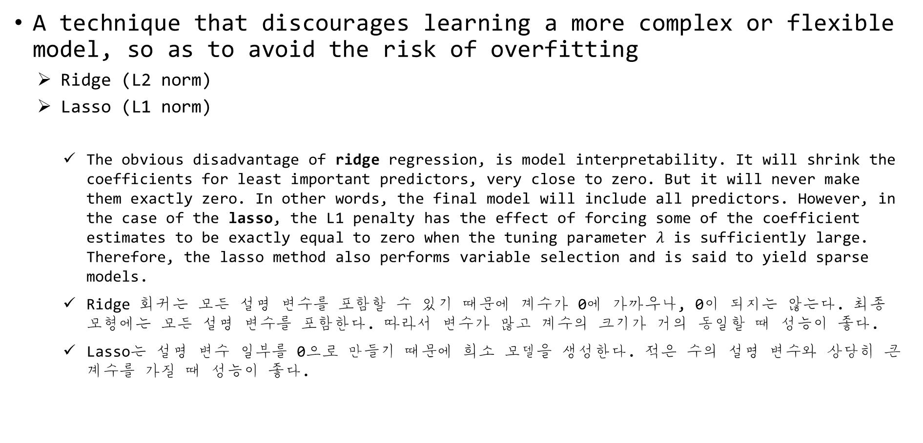
Q. What is regularization?
A technique that discourages learning a more complex or flexible model, so as to avoid the risk of overfitting
Ridge (L2 norm)
Lasso (L1 norm)
The obvious disadvantage of ridge regression, is model interpretability. It will shrink the coefficients for least important predictors, very close to zero. But it will never make them exactly zero. In other words, the final model will include all predictors. However, in the case of the lasso, the L1 penalty has the effect of forcing some of the coefficient estimates to be exactly equal to zero when the tuning parameter $λ$ is sufficiently large. Therefore, the lasso method also performs variable selection and is said to yield sparse models.
Ridge 회귀는 모든 설명 변수를 포함할 수 있기 때문에 계수가 0에 가까우나, 0이 되지는 않는다. 최종 모형에는 모든 설명 변수를 포함한다. 따라서 변수가 많고 계수의 크기가 거의 동일할 때 성능이 좋다.
Lasso는 설명 변수 일부를 0으로 만들기 때문에 희소 모델을 생성한다. 적은 수의 설명 변수와 상당히 큰 계수를 가질 때 성능이 좋다.

Slide 47
Q. Why is ReLU better than Sigmoid in NN?
Explain
Imagine a network with random initialized weights (or normalized) and almost 50% of the network yields 0 activation because of the characteristic of ReLU (output 0 for negative values of x). This means a fewer neurons are firing (sparse activation) and the network is lighter.
ReLU의 사용으로 인해 NN을 더 가볍게 할 수 있다. 몇 개의 neuron에서는 비활성되기 때문

Slide 48
Q. Computer Vision Questions 1
Given stride S and kernel sizes for each layer of a CNN, create a function to compute the receptive field of a particular node in the network. This is just finding how many input nodes actually connect through to a neuron in a CNN.
Implement connected components on an image/matrix.
Create a function to compute an integral image, and create another function to get area sums from the integral image.
How would you remove outliers when trying to estimate a flat plane from noisy samples?
How does CBIR work?
How does image registration work? Sparse vs. Dense optical flow and so on.

Slide 49
Q. Computer Vision Questions 2
Describe how convolution works. What about if your inputs are grayscale vs RGB imagery? What determines the shape of the next layer?
Talk me through how you would create a 3D model of an object from imagery and depth sensor measurements taken at all angles around the object.
Implement SQRT(const double &x) without using any special functions, just fundamental arithmetic
Reserve a bitstring
Implement non maximal suppression as efficiently as you can
Reverse a linked list in place

Slide 50
Q. What is data normalization and why do we need it?
Data normalization
Is very important preprocessing step
Used to rescale values to fit in a specific range to assure better convergence during backpropagation.
Generally, subtracting to mean of each data point, and dividing by its standard deviation.

Slide 51
Q. Why use Conv. for images rather than FC layers?
First
Convolutions preserve, encode, and actually use the spatial information from the image
If using FC layers, we would have no relative spatial information.
Second
Convolution Neural Networks (CNNs) have a partially built-in translation in-variance, since each convolution kernel acts as it’s own filter/feature detector

Slide 52
Q. What makes CNNs translation invariant?
Each convolution kernel acts as it’s own filter/feature detector.
Let’s say you’re doing object detection, it doesn’t matter where in the image the object is since we’re going to apply the convolution in a sliding window fashion across the entire image anyways.

Slide 53
Q. Why do we have max-pooling in classification CNNs?
For a role in Computer Vision.
Max-pooling in a CNN allows you to reduce computation since your feature maps are smaller after the pooling.
You don’t lose too much semantic information since you’re taking the maximum activation.
There’s also a theory that max-pooling contributes a bit to giving CNNs more translation in-variance.

Slide 54
Q. Segmentation CNNs have encoder/de- structure
The encoder
Can be thought of as a feature extraction network
The decoder
Uses that information to predict the image segments by “decoding” the features and upscaling to the original image size

Slide 55
Q. What is the significance of Residual Net?
Residual Control
Allow for direct feature access from previous layers
This makes information propagation throughout the network much easier
To avoid feature vanishing

Slide 56
Q. What is batch normalization & why use?
Batch normalization
To make mean to 0 and standard deviation to 1
This is done for each individual mini-batch at each layer normalization
This is analogous to how the inputs to networks are standardized
How does this help?
We know that normalizing the inputs to a network helps it learn
To avoid gradient vanishing/exploding
To avoid ‘Internal Covariance Shift; 각 층이나 activation 마다 input의 distribution이 달라지는 현상’

Slide 57
Q. Why use many small kernel?
Explained in the VGGNET Paper
First
You can use several smaller kernels rather than few large ones to get the same receptive field and capture more spatial context, but with the smaller kernels you are using less parameters and computations.
Second
Because with smaller kernels you will be using more filters, you’ll be able to use more activation functions and thus have a more discriminative mapping function being learned by your CNN.
계산량과 파라미터를 줄일 수 있으며, 다양한 activation 함수를 사용함으로써, 차별화된 모델을 구성할 수 있다. 또한, 큰 크기의 필터보다는 다양한 공간 정보를 활용할 수 있다.

Slide 58
Q. Stratified cross-validation
In stratified cross-validation,
The split preserves the ratio of the categories on both the training and validation datasets
Stratified cross-validation may be applied in the scenarios
On a dataset with multiple categories. The smaller the dataset and the more imbalanced the categories, the more important it will be to use stratified.
On a dataset with of different distributions. For example, the dataset for autonomous driving, we may have images taken during the day and at night. If we do not ensure that both types are present in training and validation, we will have generalization problems.

Slide 59
Q. Why do ensembles typically have higher score?
Ensemble Model
Is the combination of multiple models to create a single prediction.
The key idea for making better predictions is that the models should make different errors. That way the errors of one model will be compensated by the right guesses of the other models and thus the score of the ensemble will be higher.
하나의 모델에서 나타난 에러를 다른 모델에서 잡을 수 있으므로 상대적으로 모델 성능이 기본 모델보다는 더 좋게 나타난다.

Slide 60
Q. What is an imbalanced dataset?
Imbalanced dataset
Is one that has different proportions of target categories.
How to deal?
Oversampling or undersampling: Stratified cross-validation
Data augmentation. We can add synthetic data.
Using appropriate metrics. In the example dataset, if we had a model that always made negative predictions, it would be achieve a precision of 98%. There are other metrics such as precision, recall, and F-score that describe the accuracy of the model better wen using an imbalanced dataset.
마지막 문장은 특정 데이터셋에 걸맞는 정확도 측정 방식의 매트릭스를 사용하자는 의미이다.

Slide 61
Q. What is data augmentation?
Data augmentation
Is a technique for synthesizing new data by modifying existing data in such a way that the target is not changed, or it is changed in a known way.
Resize
Horizontal or vertical flip
Rotate
Add noise
Deform
Modify color

Slide 62
Q. What is Precision, Recall & F1-score?
Precision: 정확도
Is the fraction of relevant instances among the retrieved instances
Precision = true positive / (true positive + false positive)
Recall: 재현도
Is the fraction of relevant instances that have been retrieved over the total mount of relevant instances.
Recall = true positive / (true positive + false negative)
F1-score
It is weighted average of precision and recall. It considers both false positive and false negative into account. It is used to measure the model’s performance
F1-score = 2 * (precision * recall) / (precision + recall)

Slide 63
Q. What is cost function?
Cost function
Is a scalar function which Quantifies the error factor of the Neural Network.
Lower the cost function better the Neural Net.

Slide 64
Q. Define hyperparameters
Learning rate
Is a hyperparameter that controls how much we are adjusting the weights of our network with respect the loss gradient
Epoch
One forward pass and one backward pass of all the training examples
Batch
Examples processed together in one pass (forward and backward)
Iteration
Number of training examples / batch size

Slide 65
Q. Difference between boosting and bagging
They are similar, in that they are both ensembling techniques.
Weak learners combine to create a strong learner that can make accurate predictions
Bagging
Means that you take bootstrap samples of your dataset and each sample trains a weak learner
샘플을 가져와 이 샘플에 약한 학습자를 더 학습시키는 방식
Boosting
Uses all data to train each learner, but instances that were misclassified by the previous learners are given more weight so that subsequent learners give more focus to them during training
모든 학습자가 학습하게 되며, 이전의 학습자가 잘못 분류한 인스턴스에는 더 많은 가중치가 주어지므로, 후속 학습자는 이것에 대해 더 집중하게 된다.

Slide 66
Q. Explain how a ROC curve works
ROC curve
Is a graphical representation of the contrast between true positive rates and the false positive rate at various thresholds.
It’s often used as a proxy for the trade-off between the sensitivity of the model vs. fall-out or the probability it will trigger a false alarm (false positive)

Slide 67
Q. Difference Type I and Type II error
Type I
Is a false positive.
Means claiming something has happened when it hasn’t.
Type II
Is a false negative.
Means that you claim nothing is happening when in fact something is.

Slide 68
Q. Generative vs. discriminative model
Generative model
Will learn categories of data
Discriminative model
Will simply learn the distinction between different categories of data
Discriminative models will generally outperform generative models on classification tasks.

